Slide 1
표지

Slide 2
Company Background
C
O
N
T
E
N
T
S
External & Internal Analysis
KSFs & SCA Analysis
Marketing Strategies
Conclusion

Slide 3
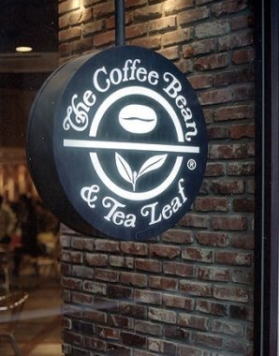
Company Background
Industry: Retail coffee and tea
Founded: Brentwood, California (1963)
Founders: Mona and Herbert B. Hyman
Headquarters: Los Angeles, California, United States
Products: Whole bean coffee, Boxed tea, Made-to-order beverages Baked goods, Merchandise
Revenue: ₩ 76 billion (2009)
Korean Market: Park, Sang Bae established Korean coffee Bean
2001 launched first coffee bean franchise store in Chung-Dam

Slide 4
Competitor Analysis
<No. of Stores>
347
5%
10%
17%
202
225
12%
165
33%
Starbuck which is No.1 and has almost 1/3 market shares is
doing the marketing activity of culture including coffee and
high premium quality.
Angel-in-us which is a subsidiary of Lotte Group is trying
varying the menu at medium and high price lower than
Coffee bean.

Slide 5
4P Analysis
A variety of products from coffee & tea to bakery
Light roast : soft & mild
Fat-free, Ice-Blended
PRODUCT
Expensive strategy ☞ luxury image
(ex, Black Forest Ice Blended regular : 6,400KW)
PRICE
High accessibility : densely populated downtown
area centering Seoul metropolitan area
All company-owned stores (low compared to rivals)
PLACE
Pink card : 12 buying and one free
Word of mouth marketing
Offering information on new product launching
thru the Internet
PROMOTION

Slide 6
STP Analysis
Segmentation
Segment | Customer needs & Features
Teenagers | Preferring carbonated beverages Familiar with Fast food Increasing the purchasing power
Twenties | Leading spending cultures A certain level of purchasing power Word of mouth effect
Thirties | Interested in cultural life Leading well-being culture
Forties | High purchasing power Mainly business meeting Unfamiliar with foreign culture
Fifties & over | High purchasing power Few demand high quality coffee Preferring healthy-drinks

Slide 7
STP Analysis
Targeting
20s and early 30s females who are interested in new trends
and leading spending cultures
A certain level of purchasing power
Positioning
Providing total quality experience : Best product quality plus
warm, cozy social gathering place
Focusing on well-being beverages (ex, Ginseng Tea)

Slide 8
KSFs of Cafe business & CAs of The Coffee Bean & Tea Leaf
Key Success
Factors
Product Quality
Q of Raw Material
Uniformity of taste among stores
Location
Accessibility
Availability
Atmosphere & Service
Comfortable place
Good Experience
Product Diversity
Roasting Style
Unique Service
Competitive
Advantages
Broad Product Line of Tea menu
Preoccupied location near the main street of downtown
Differentiated Service ex) Valet parking/ Take-out specialized store

Slide 9
Sustainable Competitive Advantage
What is Coffee bean’s Point of Differentiation(POD) ?
‘Diverse & high quality tea menu’
<Targeting>
20s and 30s women who concern about diet and well-being
Middle age for potential customers
<Positioning>
“Enjoy well-being life-style with our premium tea.”

Slide 10
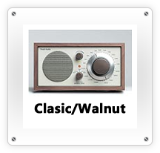
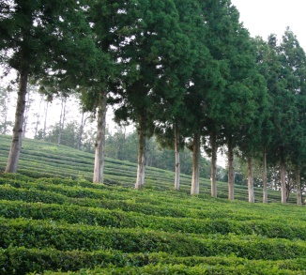
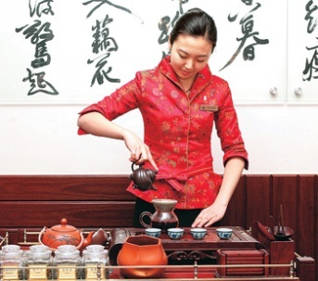
Marketing strategy - Product -
High Quality ingredient – “BoSung Green Tea”
High Value
Proposition
Tea Specialist – “ Tea Sommelier”
Product Extension – “Flower Teas”
Product Extension
Customization
Side food – “Korea Rice Cake”
Tea culture- experience at home
Market
Extension
Easy access– Sets of the Tea cups

Slide 11
Marketing strategy - Place -
In the three main different Business channel,
Coffee Bean has more accessibility on the On-line and Department store for brand value and experience at home.
Also Co-marketing with Yoga Club is more attractive at target customers.
The Coffee Bean & Tea Leaf
On-line
The Young,
Experience at home
Department store
The Rich,
Brand vale
Yoga
Co-marketing,
The Young Women

Slide 12
Marketing strategy - Promotion -
Serving Tea Lecture
PPL
Co-Marketing
Contract with local fitness club or yoga institutes
Schools, institutes
Angel-in-us in ‘(Birth of the rich)’
Genesis in 24

Slide 13
Conclusion
Change the way of thinking
Listen to loyal customers
Niche market ex)Store for men or mid-aged women
- 80/20 rule - Market trend

Slide 14
Q & A

